Slide 1
Assignment 1
Bayesian Matting
IMVFX Spring
March 25, 2020

Slide 2
Quick overview
Get some pixel values from image and apply GMM on them.
Optimize F, B and alpha value for every unknown pixel.
Attach your result to another background.

Slide 3
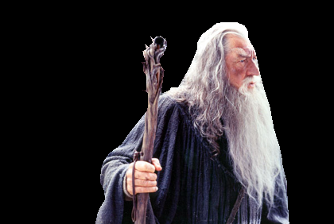


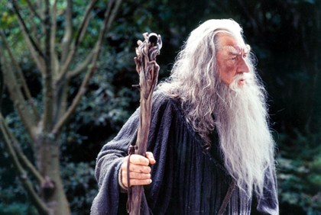
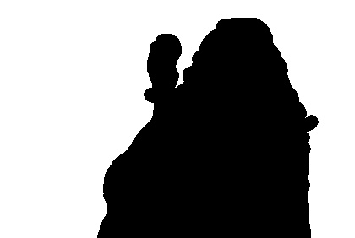
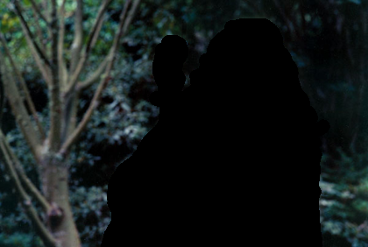
Trimap
255 for foreground, and 0 for background.
Given a trimap, we can easily get masks.
Then we can get foreground and background colors.

Slide 4


Prepare datapoints for GMM
An easy way to reduce datapoints is to use the surrounding pixels of the unknown part (Hint: cv2.dilation)
After dilation, we can get those foreground/background pixels by logically ANDing with foreground/background mask.
Then we can apply GMM (Hint: cv2.ml.EM_create)

Slide 5
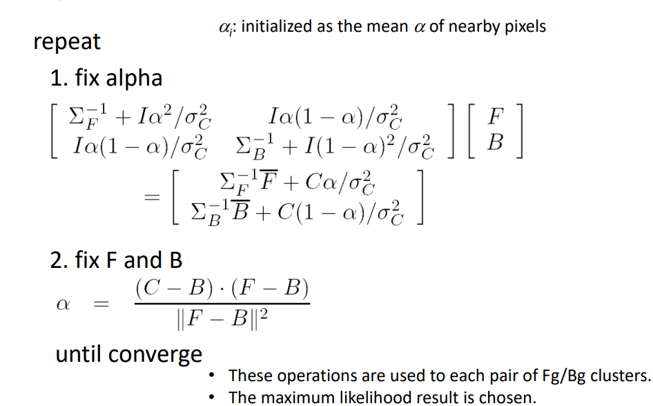
Optimization

Slide 6
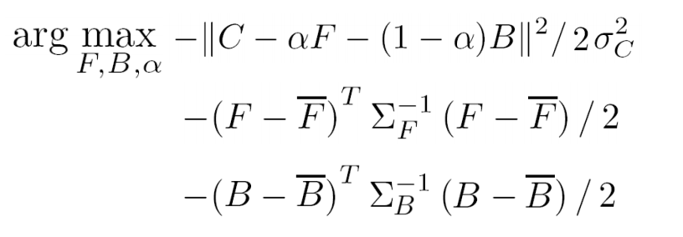
Optimization
The operations mentioned above should apply on Each Pair of foreground and background clusters (If you have 3 clusters for your foreground and background, there will have 9 pairs for you to do)
Pick the pair that has the highest likelihood as your result

Slide 7

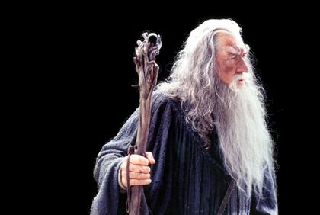
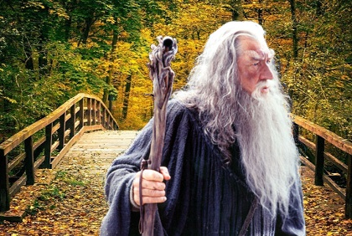
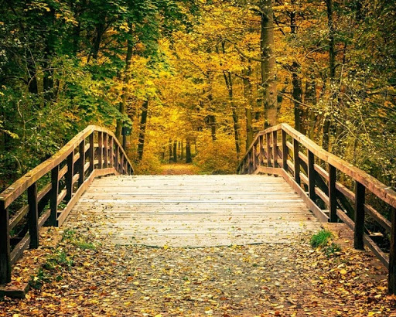
Attach result on new background
After getting F, B and 𝛼, we can simply change the old background to the new one and use the formula to get our result

Slide 8
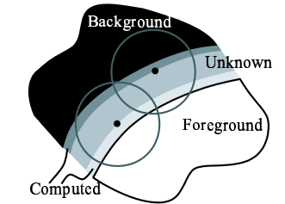

Requirements
Prepare datapoints and apply GMM
Besides dilation, you’re welcome to try any other methods you can come up with to get datapoints
Try to play with different settings. e.g. #clusters, different types of covariance matrix
Optimization
Try different settings. e.g. initial 𝛼, max iterations, terminate criteria
You can use np.linalg.inv and np.linalg.solve
Attach
pick a landscape photo on your own and try to attach your result from matting to it
Bonus
Modify the given code to utilize gaussian weights for every pixel
Work on more images (http://www.alphamatting.com/datasets.php)
Implement GMM by yourself

Slide 9
Score
Prepare datapoints and apply GMM (25%)
Optimization (30%)
Attach (6%)
quality of 3 result images (9%)
3 points if everything looks fine
2 points if some problems can be find when zooming in
1 point if problems can be find even when not zooming in
report (30%)
Explanation of all parts of your code
What you have done in your experiments and your result images (zoom in to see how’s the effect), no more than 20 pages
Bonus (at most 10%)

Slide 10

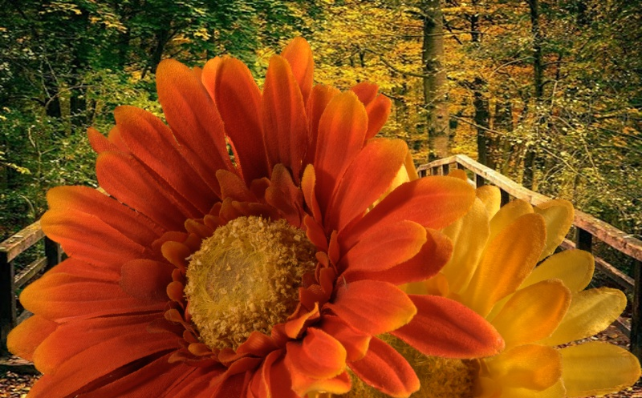
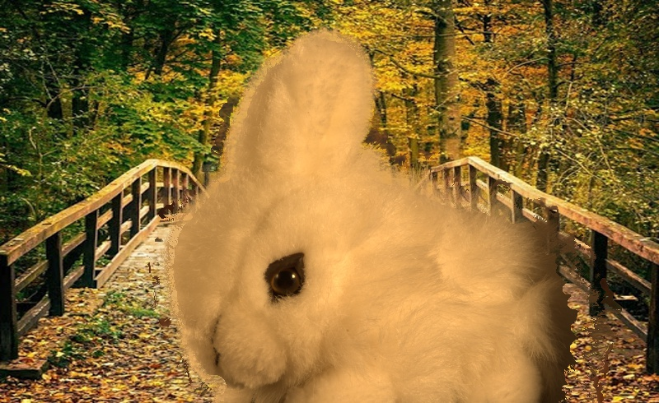
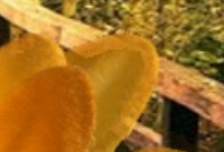
Quality example

Slide 11
Reminder
You should work on all the given images
It takes much time to process an image, so better to start your work early
Feel free to modify any code provided from TA

Slide 12
Submission
Every submission should consist of the followings:
Your code
A readme.txt file describing how to run your code
Report (in pdf format)
Please clip all your files into <student_id>.zip and submit through New e3
Due on 4/15/2020 23:55:00 PM

